Slide 1
Uva 1048
Low Cost Air Travel, LA3561
World Final 2006
Time: 3 seconds

Slide 2
Problem Description(1)
Air fares are crazy! The cost of a ticket is determined by numerous factors, and is usually not directly related to the distance traveled. Many travelers try to be creative, sometimes using only parts of tickets with stops in various cities to achieve lower-cost travel.
However, the airlines are aware of this behavior, and usually require that the travel covered by a ticket be completed in order and without intervening travel.

Slide 3
Problem Description(2)
For example, if you have a ticket for travel from City-1 to City-2 then to City-3, you are not allowed to use only the portion of the ticket for travel from City-2 to City-3.
You must always start at the first city on the ticket. In addition, you are not allowed to travel from City-1 to City-2, fly elsewhere and return, and then continue your journey from City-2 to City-3.

Slide 4
Problem Description(3)
Let’s consider an example. Suppose you are allowed to purchase three types of tickets:
Ticket #1: 1-3-4 $225.00
Ticket #2: 1-2 $200.00
Ticket #3: 2-3 $50.00
Suppose you wanted to travel from City-1 to City-3. There are two ways to get there using only the available ticket choices:
Purchase Ticket #1 for $225.00 and use only the first leg of the ticket.
Purchase Ticket #2 for $200.00 and Ticket #3 for $50.

Slide 5
Problem Description(4)
The first choice is the cheapest.
Given a set of airline ticket offers, and one or more trip itineraries, you must determine how to purchase tickets in order to minimize the cost of travel.
Each trip will be possible.

Slide 6
Input(1)
Input consists of multiple test cases, each describing a set of ticket offers and a set of trip itineraries.
Each case begins with a line containing
NT, the number of ticket offers, followed by NT offer descriptions, one to a line.
Each description consists of a positive integer specifying the price of the ticket, the number of cities in the ticket’s route, and then that many cities.
Each city in a case has an arbitrary, but unique, integer identification number.
Note that several tickets may be purchased from the same offer.

Slide 7
Input(2)
The next line contains NI, the number of trips that are to have their cost minimized.
NI lines follow, giving the itineraries for each trip. Each line consists of the number of cities in the itinerary (including the starting city), followed by that many city identification numbers, given in the order they are to be visited.
There will be no more than 20 ticket offers or 20 itineraries in a test case.

Slide 8
Input(3)
Each offer and itinerary lists from 2 to 10 cities. No ticket price exceeds $10,000.
Adjacent cities in a route or itinerary will be distinct. Tickets and trips are numbered sequentially in each set, starting with 1.
The last case is followed by a line containing a zero.

Slide 9
Output
For each trip, output two lines containing the case number, the trip number, the minimum cost of the trip, and the numbers of the tickets used for the trip, in the order they will be used.
Follow the output format shown below. The output will always be unique.

Slide 10

Sample Input / Output
number of tickets
cost + number of cities
3
225 3 1 3 4
200 2 1 2
50 2 2 3
1
2 1 3
3
100 2 2 4
100 3 1 4 3
200 3 1 2 3
2
3 1 4 3
3 1 2 4
0
Case 1, Trip 1: Cost = 225
Tickets used: 1
Case 2, Trip 1: Cost = 100
Tickets used: 2
Case 2, Trip 2: Cost = 300
Tickets used: 3 1
cities
number of trips
travelling 2 cities,
from 1 to 3
1
3
Ticket 1
225 3 1 3 4
1
4
3
Ticket 2
100 3 1 4 3
1
2
4
Ticket 3
Ticket 1
200 3 1 2 3
100 2 2 4

Slide 11
Example:
3
20 5 1 3 2 4 5
10 5 1 2 3 4 5
15 5 5 1 4 3 2
5 1 3 5 2 4
1
3
5
1
2
3
4
Ticket 2
Ticket 3
Ticket 2
10 5 1 3 5
15 2 5 1
10 5 1 2 3 4
10
(5, 5)

Slide 12
State Modeling (i, j)
state (i, j):
已經經過了幾個城市 i, 目前所在城市的編號 j
Example:
3
100 2 2 4
100 3 1 4 3
200 3 1 2 3
3 1 2 4
(0, 2)
100
(0, 4)
Ⅹ
100
(2, 4)
Ⅹ
100
(1, 1)
100
(1, 3)
Ⅹ
(3, 4)
200
100
(2, 2)
200
(2, 3)
Ⅹ

Slide 13
State Modeling (i, j)
state (i, j):
已經經過了幾個城市 i, 目前所在城市的編號 j
Example:
3
20 5 1 3 2 4 5
10 5 1 2 3 4 5
15 5 5 1 4 3 2
5 1 3 5 2 4
(3, 3)
(4, 2)
20
20
(5, 4)
20
(1, 3)
20
(5, 5)
20
(3, 1)
10
(4, 2)
(2, 2)
10
20
(3, 4)
(3, 3)
15
10
(2, 4)
20
15
(3, 3)
10
(5, 4)
(1, 1)
20
15
(3, 5)
(5, 5)
10
15
(4, 2)
(1, 2)
(3, 3)
10
(3, 1)
20
10
(2, 3)
20
(4, 2)
15
(3, 4)
20
1
3
5
1
2
3
4
10
(1, 4)
15
(3, 3)
(5, 4)
20
Ticket 2
15
Ticket 2
Ticket 3
(3, 5)
(4, 2)
(5, 5)
10 5 1 3 5
15 2 5 1
10 5 1 2 3 4
15
10
(3, 3)
10
(4, 2)
10
(5, 4)
10
(5, 5)

Slide 14
Dijkstra’s Algorithm
Dijkstra(G)
for each v ∈ V
d[v] = ∞;
d[s] = 0; S = ∅; Q = V;
while (Q ≠ ∅)
u = ExtractMin(Q);
S = S U {u};
for each v ∈ u->Adj[]
if (d[v] > d[u]+w(u,v))
d[v] = d[u]+w(u,v);
B∞
10
2
A0
4
3
D∞
5
C∞
1
S = ∅
Q = A, B, C, D

Slide 15
Dijkstra’s Algorithm
Dijkstra(G)
for each v ∈ V
d[v] = ∞;
d[s] = 0; S = ∅; Q = V;
while (Q ≠ ∅)
u = ExtractMin(Q);
S = S U {u};
for each v ∈ u->Adj[]
if (d[v] > d[u]+w(u,v))
d[v] = d[u]+w(u,v);
B∞
u
10
2
A0
4
3
D∞
5
C∞
1
S = A
Q = B, C, D

Slide 16
Dijkstra’s Algorithm
Dijkstra(G)
for each v ∈ V
d[v] = ∞;
d[s] = 0; S = ∅; Q = V;
while (Q ≠ ∅)
u = ExtractMin(Q);
S = S U {u};
for each v ∈ u->Adj[]
if (d[v] > d[u]+w(u,v))
d[v]=d[u]+w(u,v);
v
B10
u
10
2
A0
4
3
D∞
5
C5
1
v
S = A
Q = B, C, D

Slide 17
Dijkstra’s Algorithm
Dijkstra(G)
for each v ∈ V
d[v] = ∞;
d[s] = 0; S = ∅; Q = V;
while (Q ≠ ∅)
u = ExtractMin(Q);
S = S U {u};
for each v ∈ u->Adj[]
if (d[v] > d[u]+w(u,v))
d[v]=d[u]+w(u,v);
v
B10
10
2
A0
4
3
D∞
v
5
C5
1
u
S = A,C
Q = B,D

Slide 18
Dijkstra’s Algorithm
Dijkstra(G)
for each v ∈ V
d[v] = ∞;
d[s] = 0; S = ∅; Q = V;
while (Q ≠ ∅)
u = ExtractMin(Q);
S = S U {u};
for each v ∈ u->Adj[]
if (d[v] > d[u]+w(u,v))
d[v]=d[u]+w(u,v);
v
B9
10
2
A0
4
3
D6
v
5
C5
1
u
S = A,C
Q = B,D

Slide 19
Dijkstra’s Algorithm
Dijkstra(G)
for each v ∈ V
d[v] = ∞;
d[s] = 0; S = ∅; Q = V;
while (Q ≠ ∅)
u = ExtractMin(Q);
S = S U {u};
for each v ∈ u->Adj[]
if (d[v] > d[u]+w(u,v))
d[v]=d[u]+w(u,v);
v
B9
10
2
A0
4
3
D6
u
5
C5
1
S = A,C,D
Q = B

Slide 20
Dijkstra’s Algorithm
Dijkstra(G)
for each v ∈ V
d[v] = ∞;
d[s] = 0; S = ∅; Q = V;
while (Q ≠ ∅)
u = ExtractMin(Q);
S = S U {u};
for each v ∈ u->Adj[]
if (d[v] > d[u]+w(u,v))
d[v]=d[u]+w(u,v);
v
B8
10
2
A0
4
3
D6
u
5
C5
1
S = A,C,D
Q = B

Slide 21
Dijkstra’s Algorithm
Dijkstra(G)
for each v ∈ V
d[v] = ∞;
d[s] = 0; S = ∅; Q = V;
while (Q ≠ ∅)
u = ExtractMin(Q);
S = S U {u};
for each v ∈ u->Adj[]
if (d[v] > d[u]+w(u,v))
d[v]=d[u]+w(u,v);
u
B8
10
2
A0
4
3
D6
5
C5
1
v
S = A,C,D,B
Q = ∅

Slide 22
Dijkstra’s Algorithm
Dijkstra(G)
for each v ∈ V
d[v] = ∞;
d[s] = 0; S = ∅; Q = V;
while (Q ≠ ∅)
u = ExtractMin(Q);
S = S U {u};
for each v ∈ u->Adj[]
if (d[v] > d[u]+w(u,v))
d[v]=d[u]+w(u,v);
u
B8
10
2
A0
4
3
D6
5
C5
1
v
S = A,C,D,B
Q = ∅

Slide 23
Dijkstra’s Algorithm
Dijkstra(G)
for each v ∈ V
d[v] = ∞;
d[s] = 0; S = ∅; Q = V;
while (Q ≠ ∅)
u = ExtractMin(Q);
S = S U {u};
for each v ∈ u->Adj[]
if (d[v] > d[u]+w(u,v))
d[v]=d[u]+w(u,v);
How many times is ExtractMin() called?
How many times is Relax called?
A:O(V lg V + E)

Slide 24
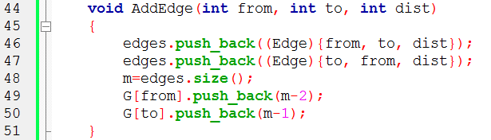

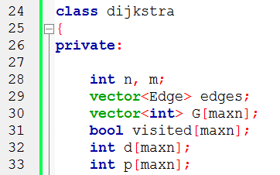
2
1
2
1 2 2
1 3 3
2 4 4
3 4 5
3
4
3
4
5
edges
0 | 1
(1,2,2) | (2,1,2)
G
1
2
3
4
0
1

Slide 25
2
1
2
1 2 2
1 3 3
2 4 4
3 4 5
3
4
3
4
5
edges
0 | 1 | 2 | 3
(1,2,2) | (2,1,2) | (1,3,3) | (3,1,3)
G
1
2
3
4
0 | 2
1
3

Slide 26
2
1
2
1 2 2
1 3 3
2 4 4
3 4 5
3
4
3
4
5
edges
0 | 1 | 2 | 3 | 4 | 5
(1,2,2) | (2,1,2) | (1,3,3) | (3,1,3) | (2,4,4) | (4,2,4)
G
1
2
3
4
0 | 2
1 | 4
3
5

Slide 27
2
1
2
1 2 2
1 3 3
2 4 4
3 4 5
3
4
3
4
5
edges
0 | 1 | 2 | 3 | 4 | 5 | 6 | 7
(1,2,2) | (2,1,2) | (1,3,3) | (3,1,3) | (2,4,4) | (4,2,4) | (3,4,5) | (4,3,5)
G
1
2
3
4
0 | 2
1 | 4
3 | 6
5 | 7

Slide 28
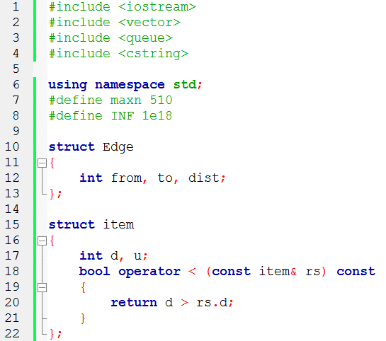
Data Structure

Slide 29
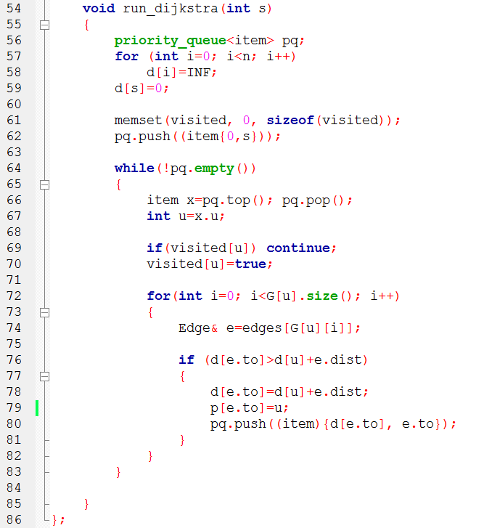
Dijkstra
Initialization

